Slide 1


Optical Character Recognition(OCR) for
Data Collection
Presented By
Arnab Sen Sharma
Reg : 2013331017
Maruf Ahmed Mridul
Reg : 2013331015
Supervisor
Md Saiful Islam
Assistant Professor
Department of
Computer Science & Engineering

Slide 2
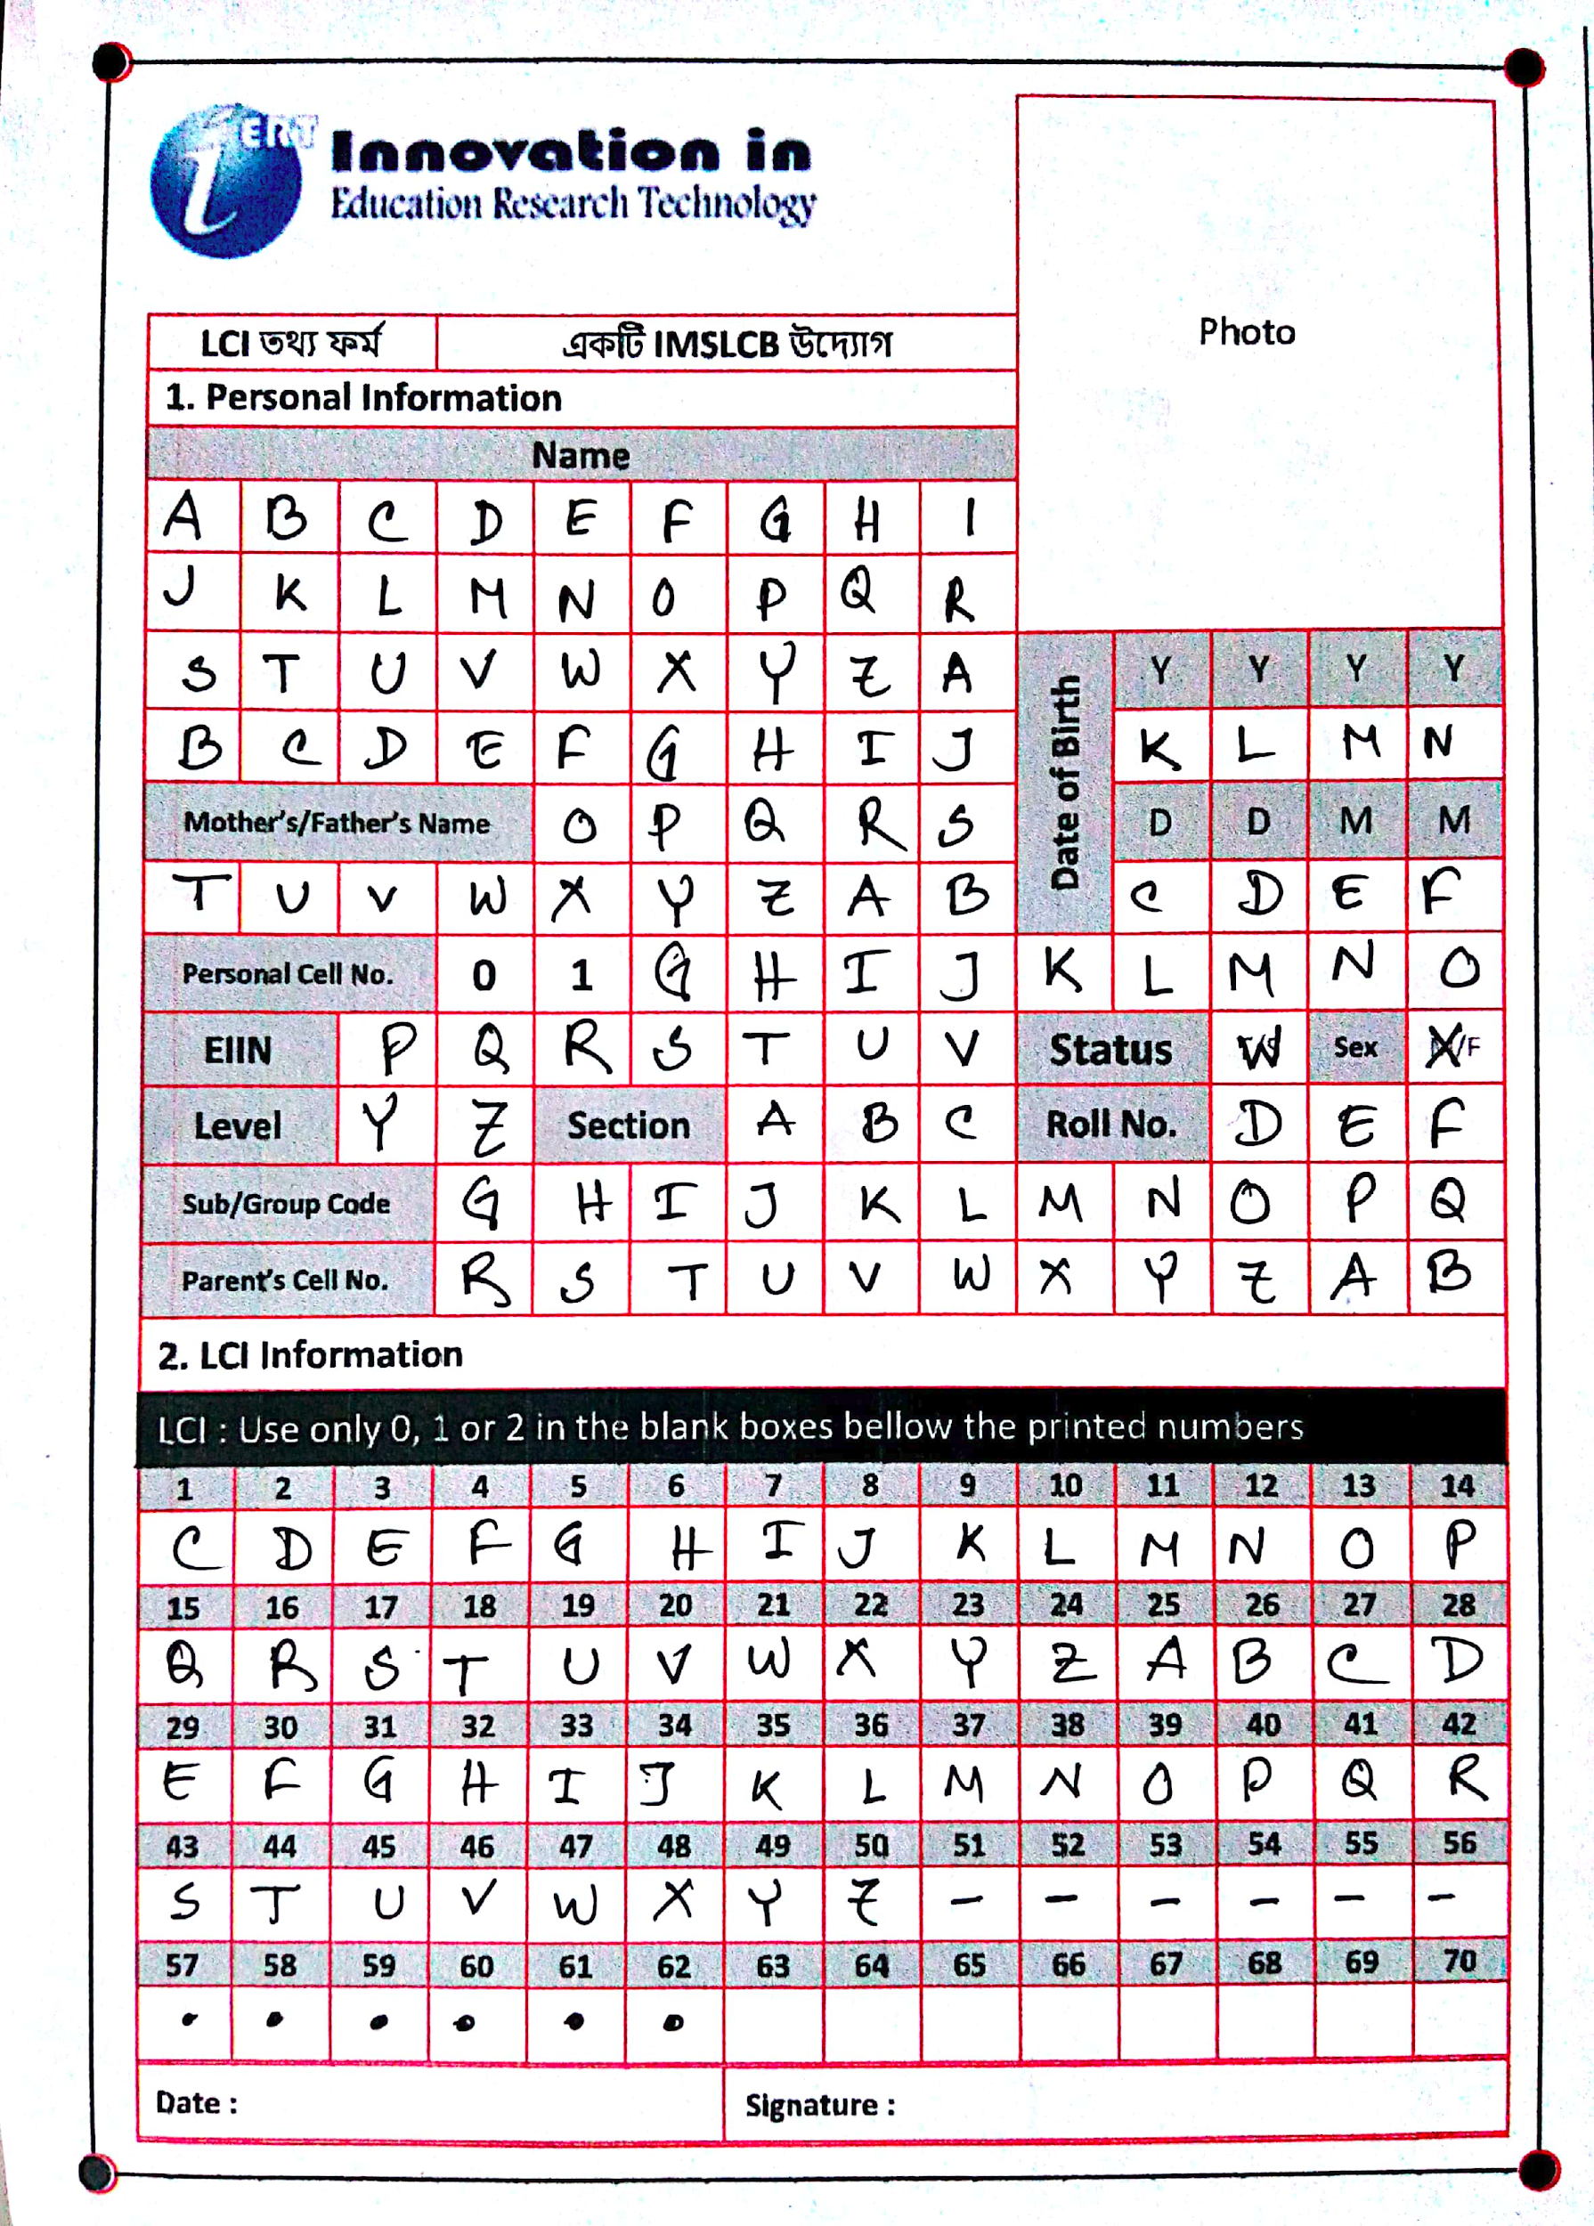
AIM
Text File
1

Slide 3
WHY ?
Main purpose is to collect data and prepare a character dataset.
176 characters (Capital alphabets and digits)
3 images
A photo
A signature
A date
From a single form !
1

Slide 4
METHODOLOGY
Cropping and Aligning
Input (Form)
Cell Extraction
Feeding the trained model
Feature Extraction
Preprocessing
Predictions
Text File
1

Slide 5
FORM SPECIFICATION
Should be Color Printed
Should be scanned by
CamScanner without flash
No background is allowed
Image should be Portrait
1

Slide 6
CROPPING AND ALIGNING
Detecting the Markers
Blob Detector Fails !
Different Image Scenarios
Minimum average pixel
value works !!
Dynamic Programming
Convex Hull
1

Slide 7
CROPPING AND ALIGNING
Perspective Transformation
after cropping
1

Slide 8
CELL EXTRACTION
Extracting each cell by splitting each row into 14 (columns) parts
Removing unnecessary cells
Top Left and Bottom Right Corners finding for 16 rows
Cropping the rows
1

Slide 9
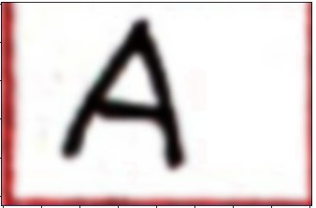
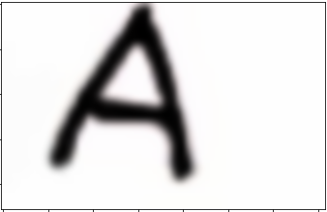
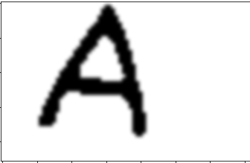


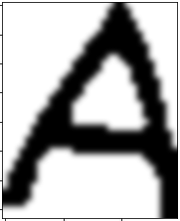

PREPROCESSING
Initial
Denoised & Border Removed
Thresholded
Resized (28 X 28)
Inverted
Middled
Cropped
1

Slide 10
FEATURE EXTRACTION
Pixel Values are the only feature
1 X (28X28) feature vector
Binarized pixel values (0 or 1)
1

Slide 11
SOME PREDICTIONS FROM THIS STAGE
Space :
< 20 white pixels
Dot :
> 20 and < 50 white pixels
1

Slide 12
TRAINING AND TESTING DATASET
Online data
EMNIST dataset for letters and digits
A_Z Handwritten alphabets from Kaggle
Real time data
From 120 persons using our form
Around 700 characters each
1

Slide 13
Models
Three models
A-Z English capital letters
0-9 English digits
0-2 English digits
1

Slide 14
Model Structure(Alphabet)
2D convolutional layer with 32 filters, which takes 28*28 grayscaled image as input
Pooling layer of 5*5. Activation function ReLU.
Another 2D convolution layer.
Another pooling layer of 5*5.
Hidden layer of 512 neurons.
Dropout of 0.25
Output layer: Number of classes. Activation function Softmax.
Loss: Categorical Cross Entropy. Optimizer: Adam.
1

Slide 15
Training the model
Alphabet: EMNIST + Kaggle. 20,000 samples for each class.
Digit: EMNIST. 28000 samples for each class.
Divided dataset using sklearn’s train_test_split function. 85% in training.
Accuracy:
Alphabet: 98.76%
Digit: 99.38%
1

Slide 16

Testing the model
Tested the model on the dataset collected by us via the form.
Performance:
Alphabet: 78.36%
Digit: 82.58%
1

Slide 17
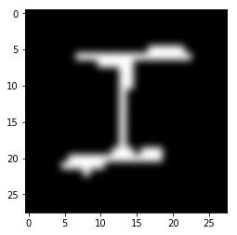
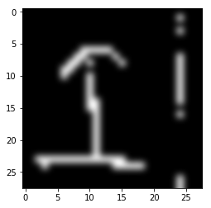
Why the poor performance?
Vs
1

Slide 18
Approach 1
Discard the online dataset. Train the model using only our dataset.
Insufficient data. Too much noise. Very poor performance on evaluation dataset.
1

Slide 19
Approach 2
Train with online dataset + our dataset.
A bit better performance.
Alphabet: 83.93%
Digit: 88.87%
Amount our dataset is very low compared to amount of online dataset.
1

Slide 20
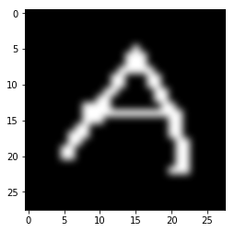
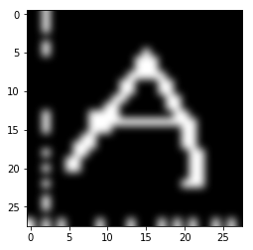
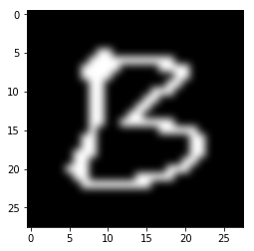
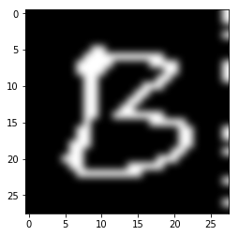
Approach 3
Modify the online dataset. Merge with our dataset.
1

Slide 21
Approach 3 (Cont.)
Performance is improved significantly!!!
Alphabet: 94.39%
Digit: 96.58%
Digit(0-2): 98.77%
1

Slide 22
FAILING CASES
I and T
O and D
P and D
B and D
C and O
U and V etc.
May be interchanged sometimes for some
valid reasons
1

Slide 23
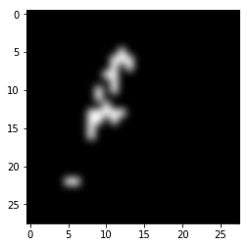
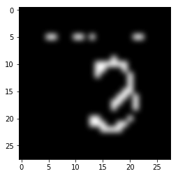
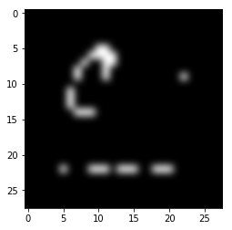
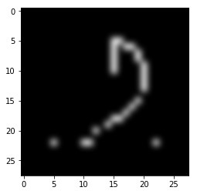
FAILING CASES (Cont.)
Everything depends on Good Scanning !!
1

Slide 24
FUTURE WORKS
Achieve the actual goal, that means real time run and collect the data.
1

Slide 25
Thank You

Slide 26
Questions and Suggestions ?

